Slide 1

Intro to Git & Github

Slide 2


+
Version control
system
GitHub
Code sharing platform

Slide 3

Why version control?
Backups
Experimentation
Collaboration

Slide 4
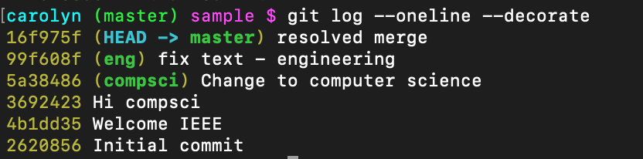
Repository
Snapshots of your code
You decide when to take the snapshot

Slide 5

git clone
git add
git commit
git status
git pull
git push
And a few more...
git log
git branch
git checkout
git merge
git diff
Notes:
We’ll go over a demo of some basic
First let’s go over some high level concepts of how git works, so you are better able to deal with challenges.

Slide 6


Pros
Powerful
Versatile
Abstract
Cons
Complex
Not much UI
Need to impose a workflow

Slide 7



Slide 8

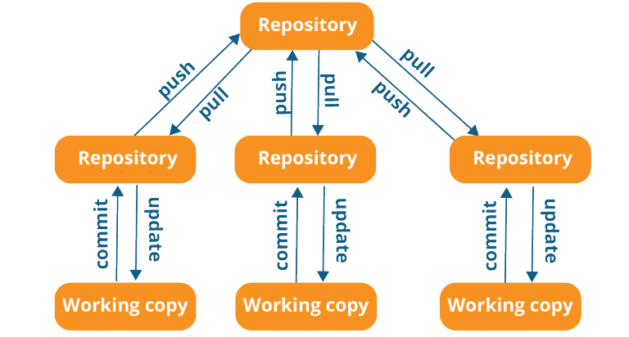

Git is a distributed version-control system

Slide 9
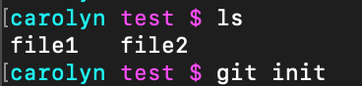
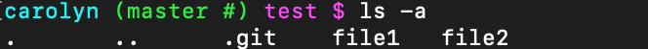
How do you create a repository?
git init
Now you have a git repository!

Slide 10
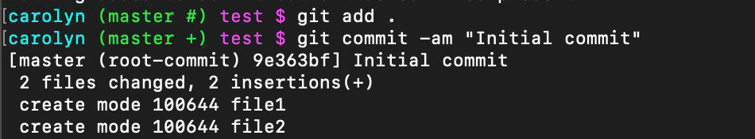
First commit

Slide 11
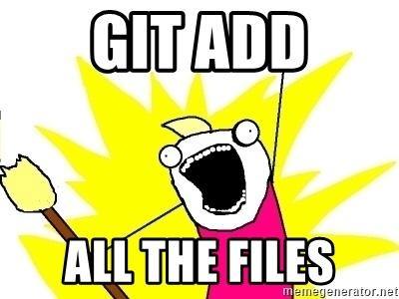
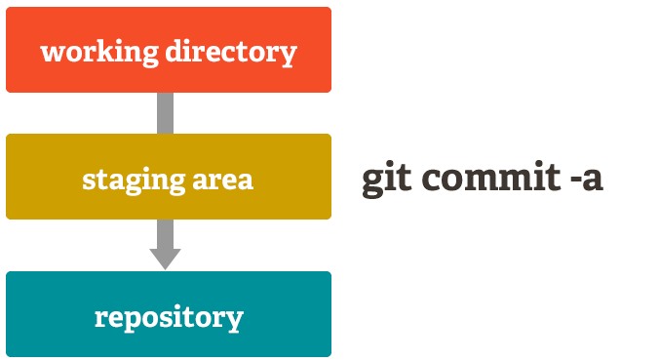

Slide 12

When to commit?
After each logical change
When is a commit too small?
When is a commit too big?

Slide 13
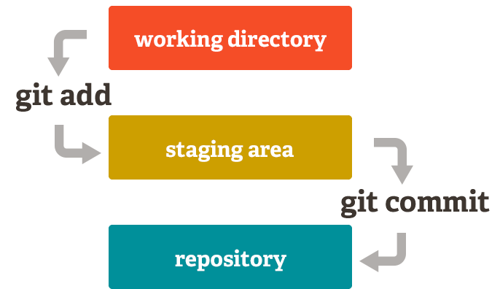
git add login.js
git commit login.js

Slide 14
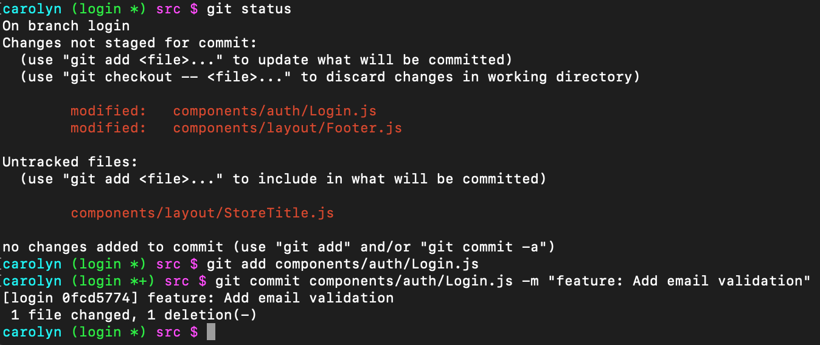

Slide 15
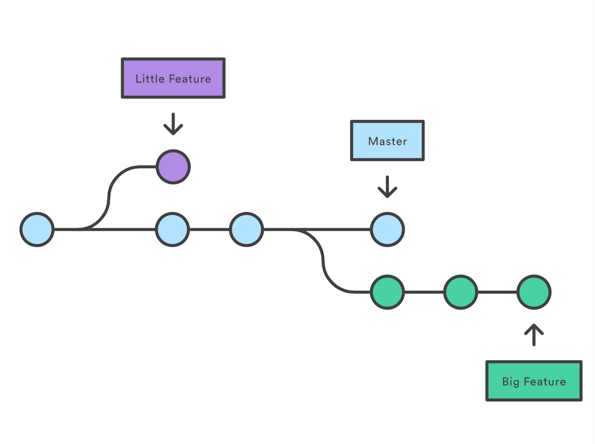
Branching

Slide 16
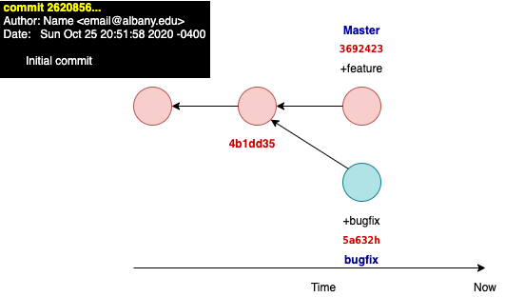

Branching
&Checkout

Slide 17
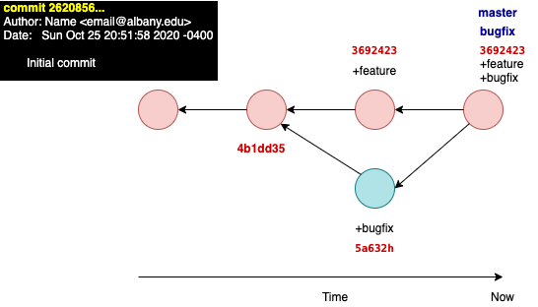
Branching
&Checkout
&Merging
Notes:
Branching merging checkout
DAG

Slide 18
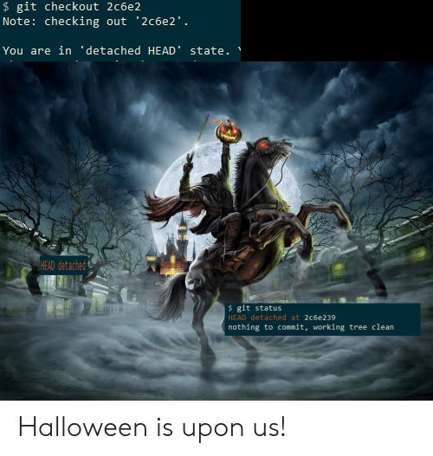

Slide 19
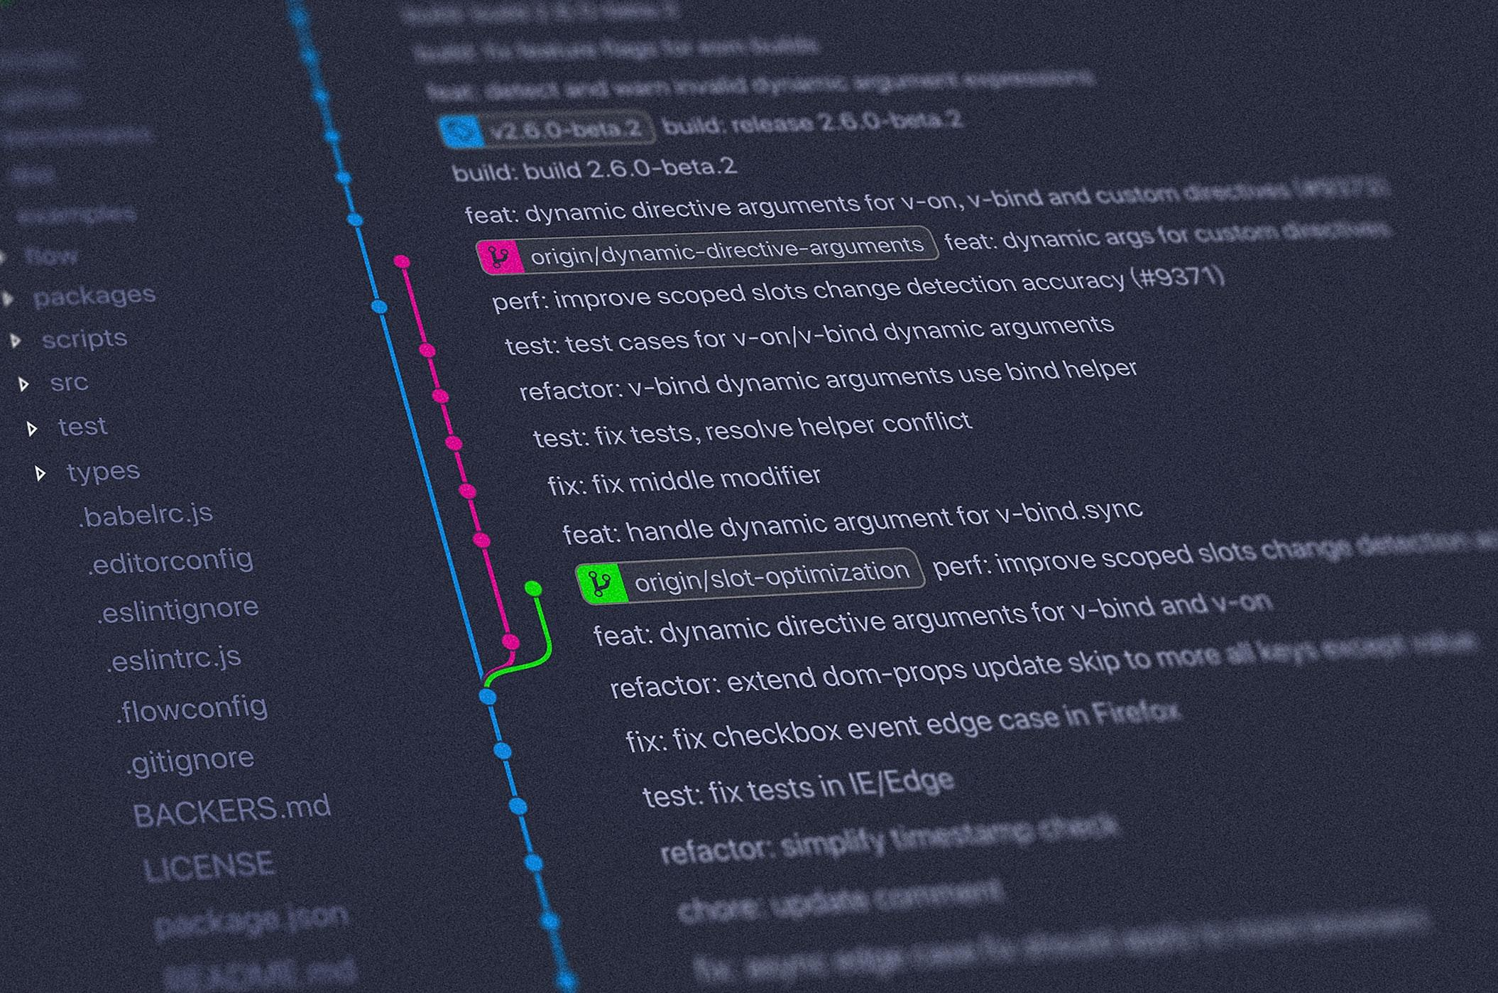

Slide 20

Merge conflicts

Slide 21

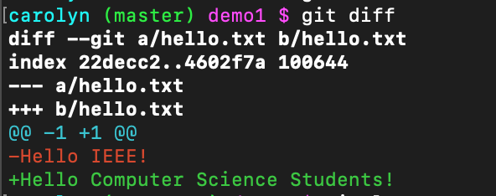
Git diff

Slide 22

Configure git
Autocomplete commands
Branch in command prompt
Set up diff3

Slide 23

GitHub

Slide 24

Get started
Add profile pic
Make a repository
Fork a repository

Slide 25

Custom profile
Create a repository named <your-user-name>
The readme.md file will now be your profile!
Include emojis, headers, stats, etc.

Slide 26
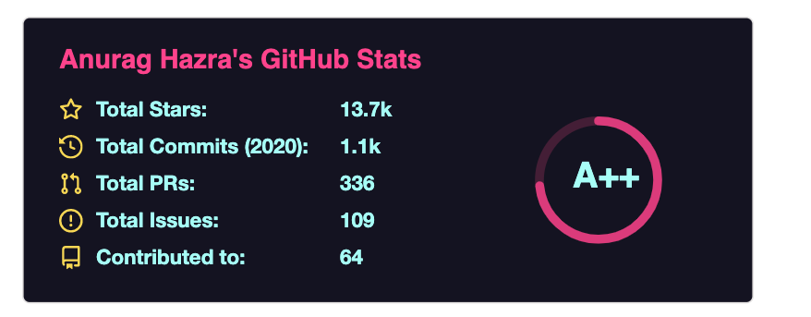

Make your profile pop
Add stats cards https://github.com/anuraghazra/github-readme-stats

Slide 27
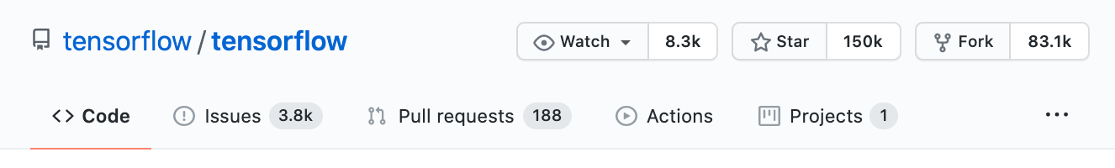
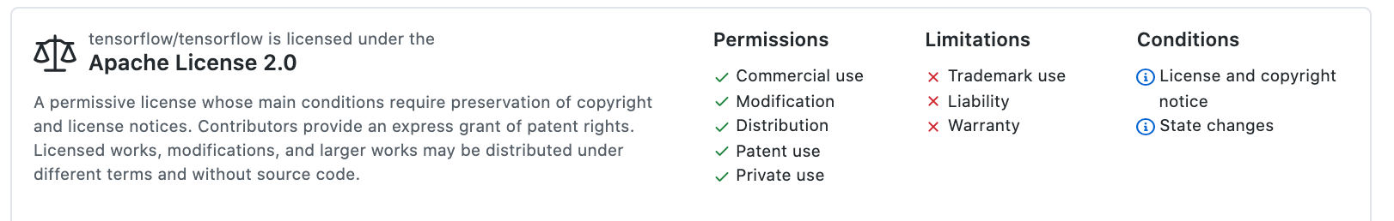

Fork some code

Slide 28

Contribute!
Tons of open source projects
Look for the tag “good first issue”
Pull request

Slide 29
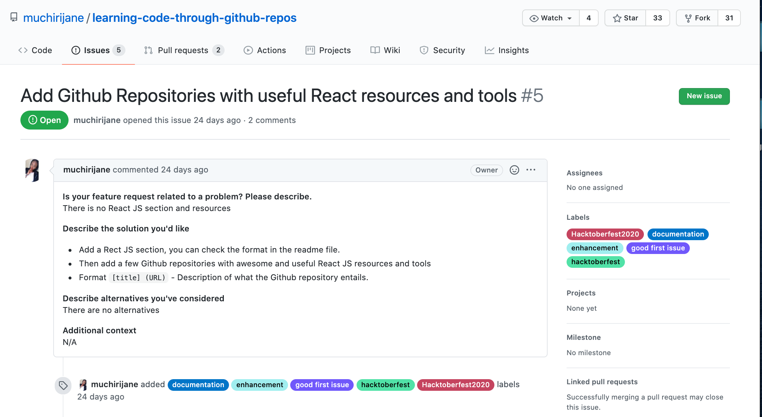

Slide 30
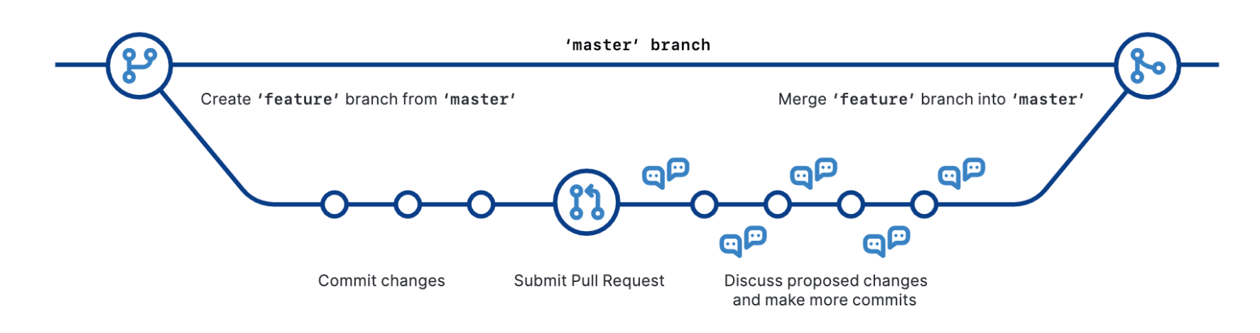
GitHub Flow

Slide 31

Get the Student Developer Pack
https://education.github.com/pack/offers
Free github pro
Other software deals, often free

Slide 32
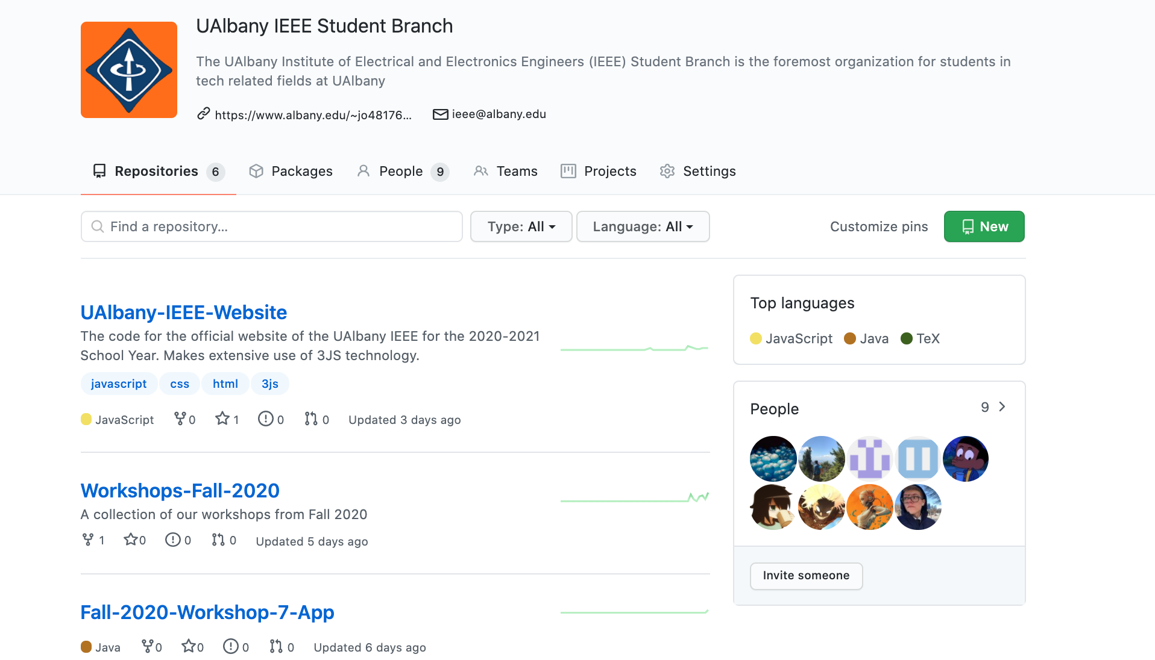

Slide 33

Image Sources https://git-scm.com/about/staging-area
https://www.edureka.co/blog/what-is-git/
https://github.com/github/training-kit/blob/master/downloads/github-git-cheat-sheet.pdf
https://app.speckbit.com/roadmap/git-and-github/2/4

